Slide 1
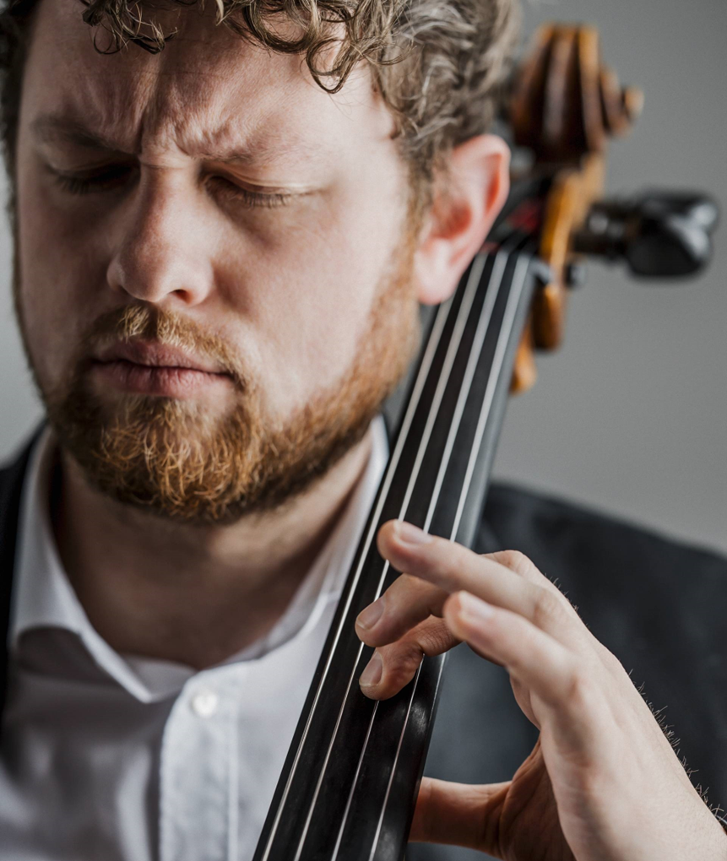
BELLOWS COLLEGE
School of music
Empowering students to discover their innate creativity through instrumental music, song, dance, and visual arts.

Slide 2


Student-led learning
School of Music
Left: Student rehearsing, right: Violinist at spring recital
Allowing students to gravitate toward the artistic focus that naturally inspires them creates impassioned artists and life-long learners.

Slide 3
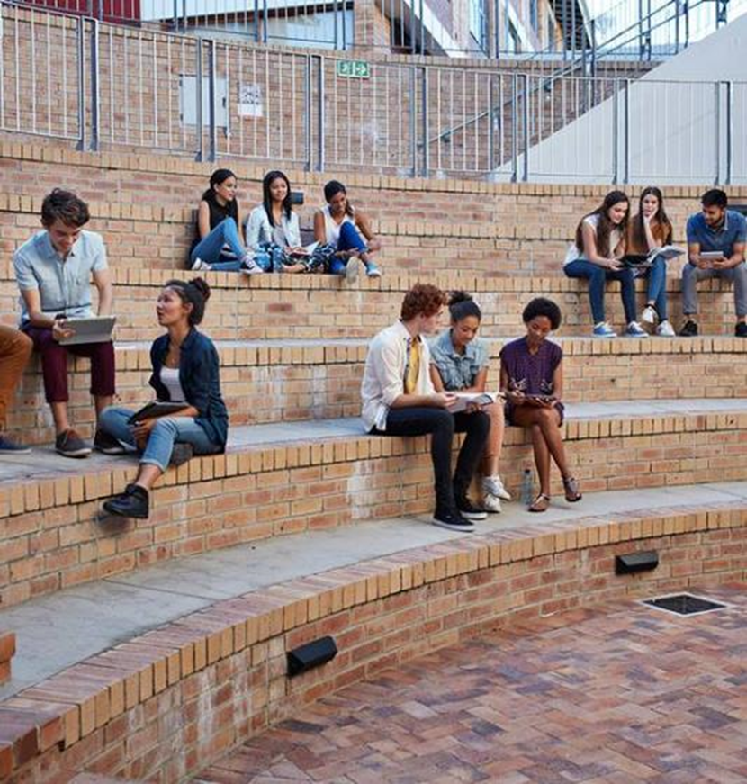

Study music theory
School of Music
Students at Bellows College spend hours each day learning, understanding, and utilizing music theory in their studies.
Students studying in the library
Theater students in small group work

Slide 4


Academic and musical excellence
School of Music
After graduation, many students from Bellows College go on to perform in professional ensembles such as the Metropolis City Orchestra.
Performance by Keita Aoki

Slide 5
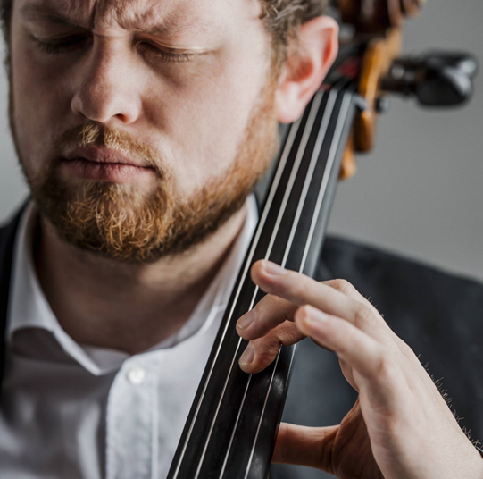


Art – at the heart of all we do
School of Music
We are truly inspired by our students and staff here at Bellows College. Artists who put their heart into all they do continue to enrich the lives of those around them.
Noah Sørensen playing cello
String orchestra students
Percussion class performance

Slide 6


Instrument
School of Music
The
Artists
Musician
Saxophone
Piano
Electric Guitar
Drums
Mirjam Nilsson
Victoria Lindqvist
August Bergqvist
Alexander Martensson

Slide 7
From the school of music
Thank
You

